Slide 1
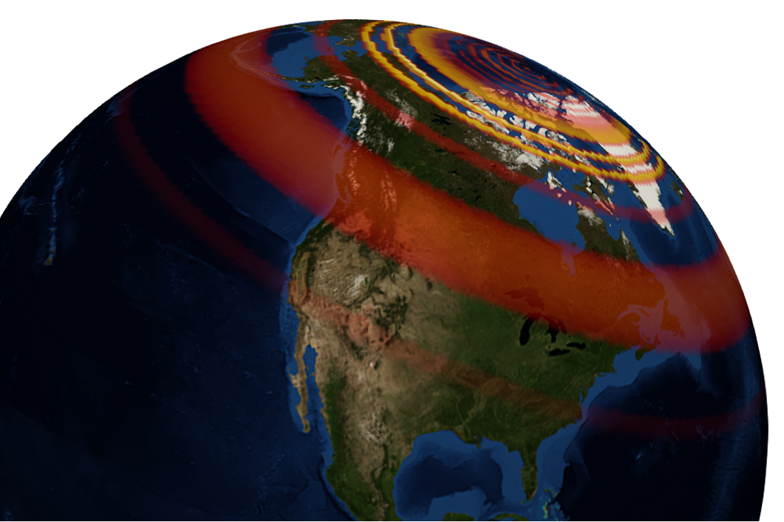
GEOL593: Seismology and Earth Structure, Spring 2023
Lecture 9: Anisotropy and Anelasticity
3/2/23
Ross Maguire
rossrm@illinois.edu
3014 NHB

Slide 2
Class schedule
 | Dates | Topic | Lab assignment
Week 1: | Jan 17, Jan 19 | Course overview | Lab 1: Python crash course
Week 2: | Jan 24, Jan 26 | Seismic signal processing | Lab 2: Introduction to Obspy
Week 3: | Jan 31, Feb 2 | Moment Tensors/ Inverse methods | Lab 3: Moment tensor inversion
Week 4: | Feb 7, Feb 9 | 🤮 No class, Ross ill | Seismic wave propagation 1
Week 5: | Feb 14, Feb 16 | Lab 4: Reference Earth models: The “1D” Earth | Seismic wave propagation 2
Week 6: | Feb 21, Feb 23 | Lab 5: Surface wave dispersion | Surface waves and normal modes
Week 7: | Feb 28, Mar 2 | Lab 6: Normal modes | Imaging Earth Structure 1: Seismic tomography
Week 8: | Mar 7, Mar 9 | Lab 7: Seismic Tomography | Imaging Earth Structure 2: Seismic discontinuities / Research paper discussion
Week 9: |  | Spring break
Week 10: | Mar 21, Mar 23 | Lab 8. Receiver Functions | Anisotropy and anelasticity
Week 11: | Mar 28, Mar 30 | Planetary seismology 1 | Lab 9: InSight- Seismology on Mars
Week 12: | Apr 4, Apr 6 | Planetary seismology 2
Week 13: | Apr 11, Apr 13 | Machine learning in seismology 1 | Lab 10: Earthquake detection
Week 14: | Apr 18, Apr 20 | Machine learning in seismology 2
Week 15: | Apr 25, Apr 27 | Frontiers of seismology: What’s next?
Week 16: | May 2, May 4 | Research paper presentations

Slide 3
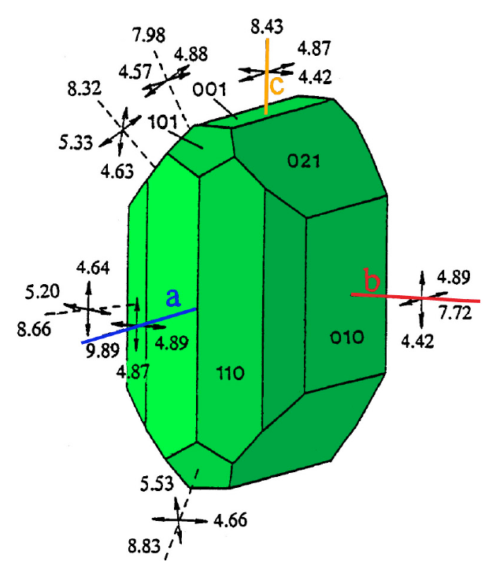
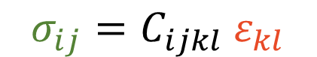
Anisotropy and symmetry
Generalized Hooke’s law
Specifying all 21 at every point is needed to describe the elastic response of a medium with general anisotropy
The “stiffness” of the medium – i.e. how hard you have to pull to stretch it – depends on the direction in which you pull
Individual minerals that make up rocks can have symmetries:
Triclinic → 21 elastic constants, e.g. albite
Monoclinic → 13 elastic constants, e.g. orthoclase
Orthorhombic symmetry → 9 elastic constants, e.g. olivine
Trigonal symmetry → 6 elastic constants, e.g. quartz
Hexagonal symmetry → 5 elastic constants, e.g. apatite
Cubic symmetry → 3 elastic constants, e.g. galena
Earth is (mostly) isotropic at large scales → 2 elastic constants c
$$σ_{ij}=C_{ijkl} ε_{kl}$$
3 x 3 tensor
3 x 3 tensor
3 x 3 x 3 x 3 tensor with 21 independent elastic constants
Olivine crystal ((Mg,Fe)2 SiO4)
[0 0 1]
[0 1 0]
[1 0 0]
7.72 km/s
9.89 km/s

Slide 4
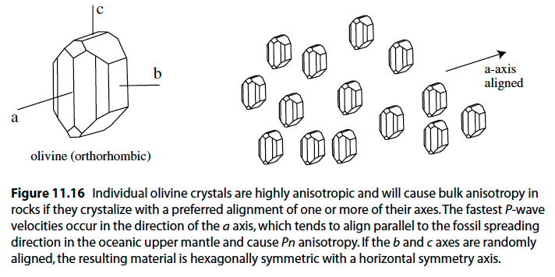
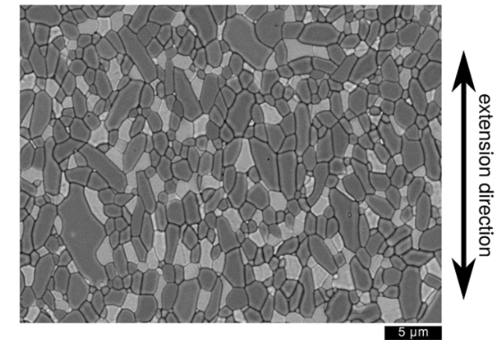
Mechanisms of anisotropy
If intrinsically anisotropic minerals are in a random orientation, the anisotropy of the aggregate will be negligible. (different orientations of anisotropy cancel each other out)
However, if crystallographic axes are aligned, the aggregate will be anisotropic. The alignment of crystal axes can be caused by strain.
Anisotropy due to the alignment of individual crystals is referred to as either crystallographic preferred orientation (CPO), or sometimes lattice preferred orientation (LPO).

Slide 5
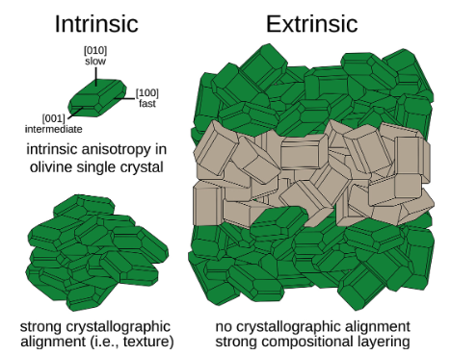
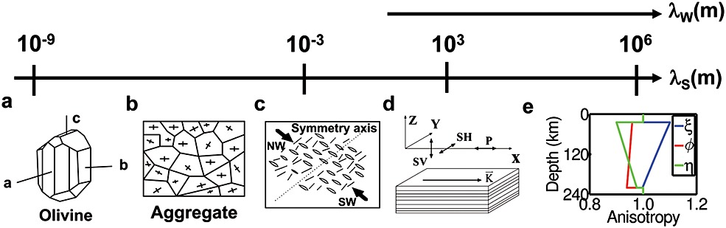
Intrinsic vs extrinsic anisotropy
CPO/LPO (i.e., anisotropy due to preferred orientation of crystals) is known as intrinsic anisotropy.
However, anisotropy can also be caused by other mechanisms, including layering of (an)isotropic materials, cracks with preferred orientation, or partial melting.
This type of anisotropy is known as extrinsic anisotropy.
Mechanisms that produce intrinsic or extrinsic anisotropy occur at a wide variety of length scales, some of which are much smaller than seismic wavelengths.
Wang et al., (2013) Geophysical Research Letters

Slide 6
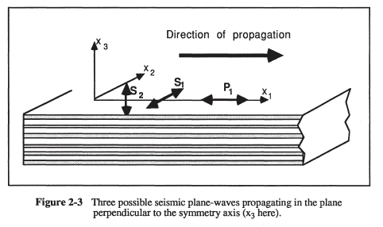
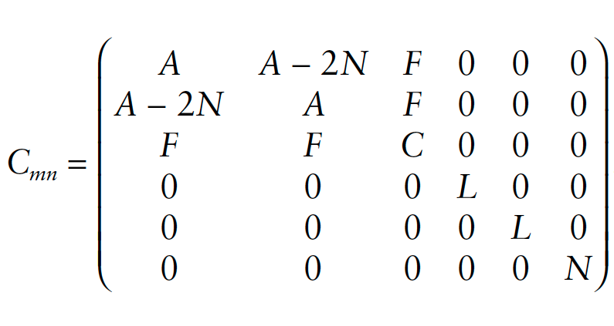
Radial anisotropy (aka transverse isotropy)
A special type of anisotropy known as radial anisotropy occurs for the case of a sequence of layers with varying material properties.
In a radially anisotropic material, waves with particle motions in the vertical direction will travel at different velocity than waves with motion in the horizontal direction.
This is sometimes referred to as ‘hexagonal’ or ‘cylindrical’ symmetry, with a vertical axis of symmetry.
It can be characterized using only 5 independent elastic constants, named A, C, F, L, and N.

Slide 7
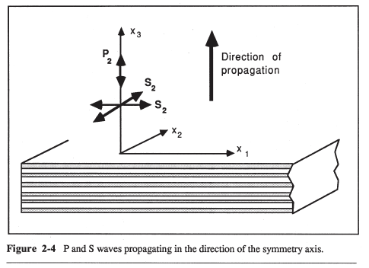
Radial anisotropy (aka transverse isotropy)
The wave velocities depend on the direction of propagation relative to the symmetry axis.
For vertically propagating waves in a radially anisotropic medium, S wave velocity is the same regardless of polarization direction
Babuska & Cara (1991)

Slide 8
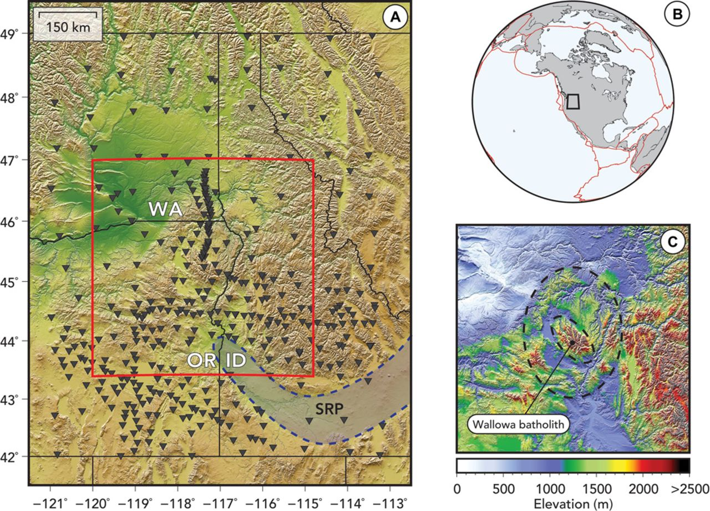
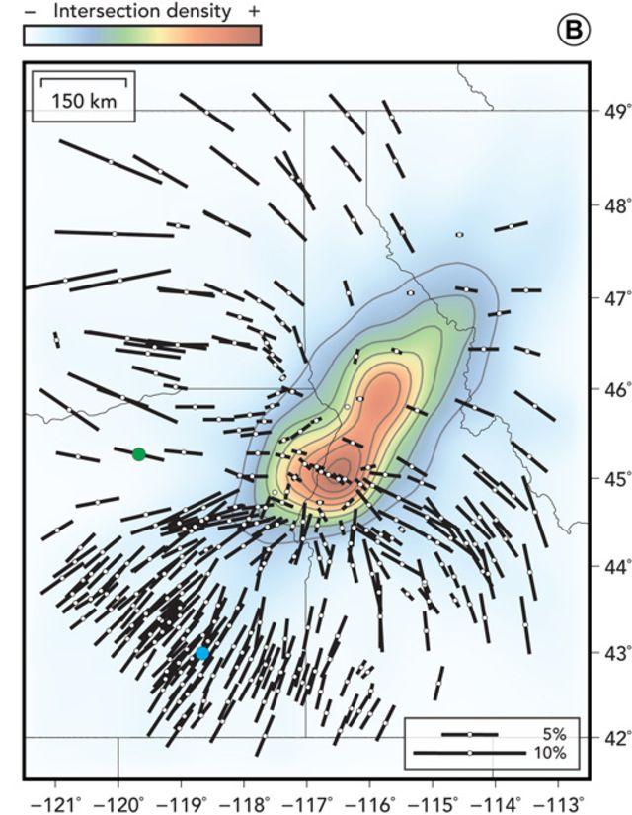
Azimuthal anisotropy
A second type of anisotropy is known as azimuthal anisotropy, in which the wave velocities vary as a function of horizontal direction.
Horizontally fast and slow directions likely relate to the pattern of deformation (e.g., mantle flow)
Structures with a vertical axis of symmetry (i.e., cylindrical symmetry) do NOT exhibit azimuthal anisotropy.
Fast direction indicates mineral alignment orientation
Castellanos et al., 2020

Slide 9
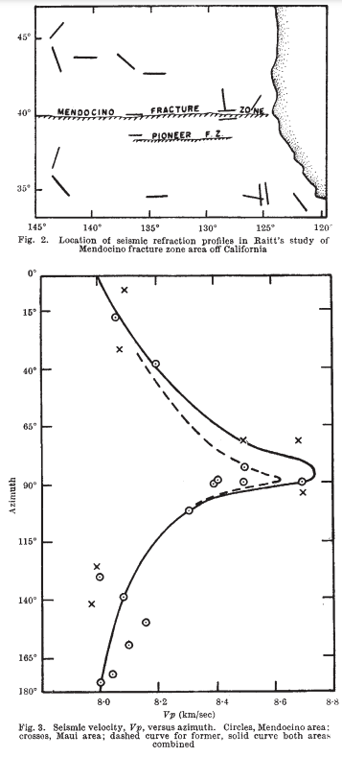
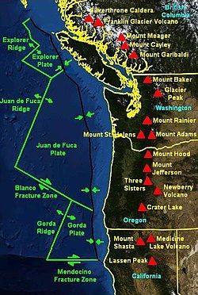
Seismic observations of anisotropy
The first observation of seismic anisotropy in Earth’s mantle was documented in Hess (1964)
In this study, mantle velocities obtained from marine seismic refraction profiles across the Mendocino triple junction were found to depend on the azimuth of the profile, with the fastest direction in the direction of plate motion.
Olivine a-axes (stiffest) tend to align parallel to the spreading direction.

Slide 10
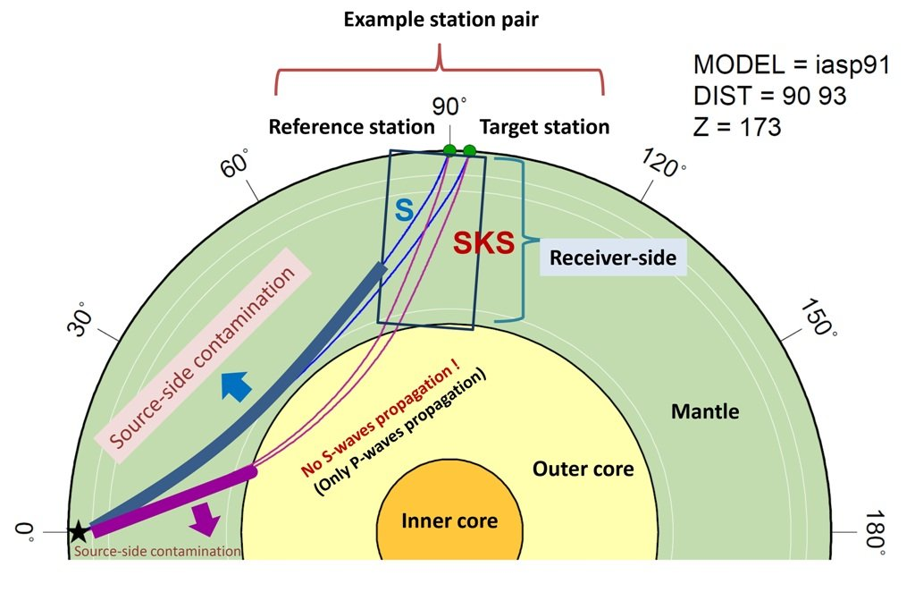
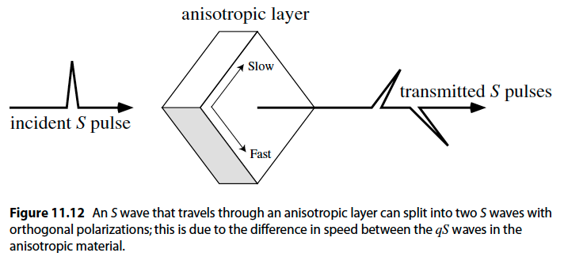
SKS Splitting
One common way of studying azimuthal anisotropy is using travel times of SKS waves (S waves converted to P waves in the core).
When S converts or P in the core, no SH motion is transmitted, so the exiting S wave has a known polarization in the radial direction.
If no azimuthal anisotropy existed, SKS would only be observed on the radial component. If it does exist, the waves ‘split’, and energy will be seen on both radial and transverse.
Polarization directions of the two S waves give the fast /slow direction, and travel time delays yield anisotropy strength.

Slide 11
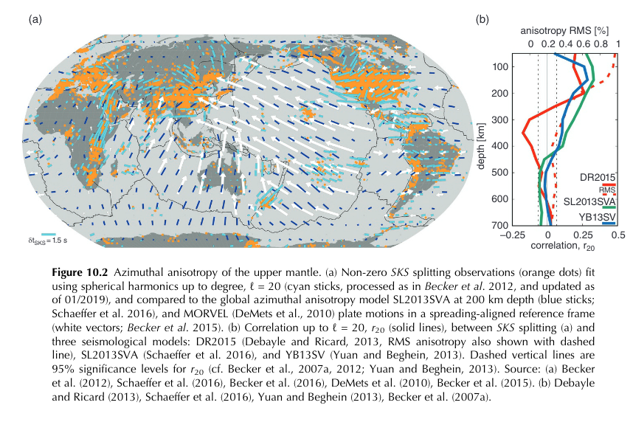
Global azimuthal anisotropy
SKS splitting gives ‘point’ measurements below seismic stations.
Azimuthal anisotropy in the upper mantle can also be mapped using global surface wave tomography. In general, fast directions determined from SKS splitting measurements agree with those in global tomography models.
The fast directions align well with global plate motions! This suggests a mechanism of lattice preferred orientation of olivine crystals.
This confirms that mapping azimuthal can be used to infer mantle flow.
Becker and Lebedev, 2021

Slide 12
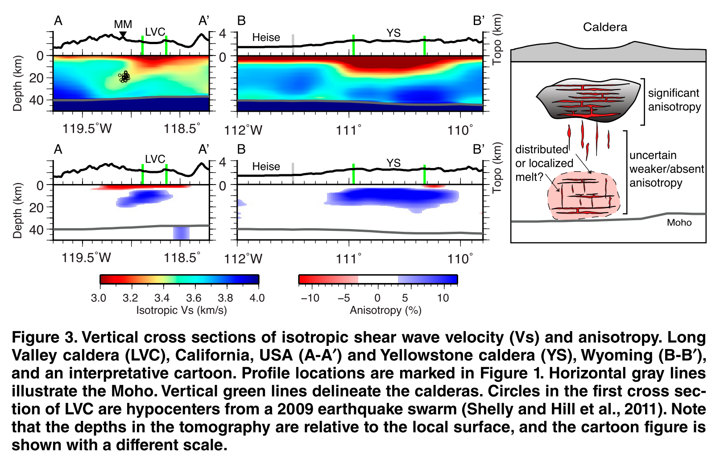
Radial anisotropy from surface waves
Radial anisotropy can also be studied by fitting surface wave dispersion of Rayleigh and Love waves.
In cases of horizontal layering, it is often found that VSH (constrained by Love wave velocities) is greater than VSV (constrained by Rayleigh wave velocity).
When V_{SH} > V_{SV}, it is referred to as positive radial anisotropy.
Positive radial anisotropy is often found in regions where partial melt is present, and can indicate that magma is organized in thin, sheet-like sill complexes
Positive radial anisotropy in the crust below silicic calderas
Jiang et al., (2018)

Slide 13
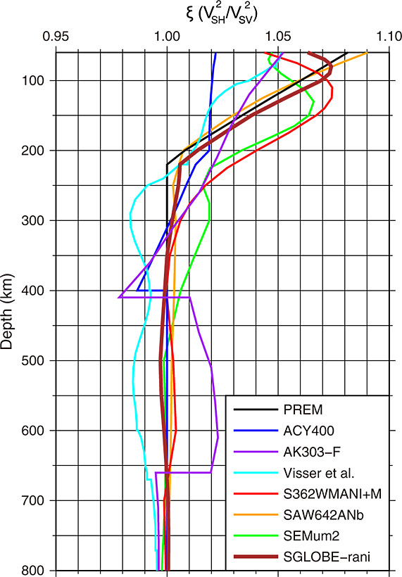
Anisotropy in global reference models
‘1D’ reference Earth models (e.g., PREM) have positive radial anisotropy in the asthenosphere.
But why? We said that alignment of olivine crystals due to deformation causes azimuthal anisotropy…
Different directions of azimuthal anisotropy average out, and the remaining effect is radial anisotropy due to horizontally oriented olivine minerals
Chang et al. (2015), JGR: Solid Earth

Slide 14

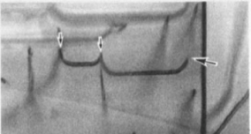
Seismic attenuation
The decrease in amplitude of seismic waves as they propagate is referred to as attenuation. There are multiple mechanisms that reduce/modify seismic amplitudes…
Extrinsic attenuation
incoming elastic energy
is conserved
Intrinsic attenuation
incoming elastic energy
is transformed
Geometrical spreading
Focusing/Defocusing
Scattering
Anelasticity
(dislocations, diffusion, … )
Karato & Spetzler [1990]

Slide 15
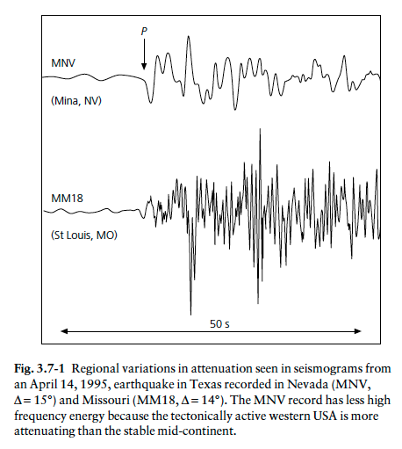
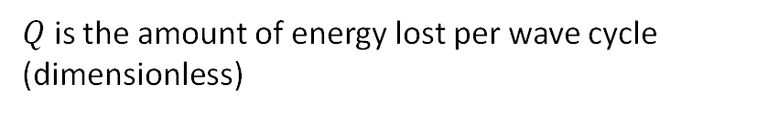
Intrinsic attenuation
Rocks act as an “absorption band” at frequencies from mHz – Hz
Loss of energy due to:
Migration of crystal dislocations
Grain boundary sliding -> grain size dependent behavior
$Q$ is the amount of energy lost per wave cycle (dimensionless)
= peak strain energy
= energy loss per cycle

Slide 16
Microscopic attenuation mechanisms
Incident seismic wave
Elastic energy of waves is consumed in dissipative processes (Knopoff, 1964)
Many different dissipation mechanisms exist in the mantle
(e.g. Jackson and Anderson 1970)
external gradient

Slide 17
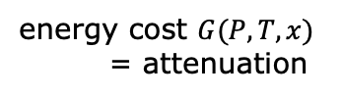
Microscopic attenuation mechanisms
Incident seismic wave
energy cost $G(P,T,x)$
= attenuation
Elastic energy of waves is consumed in dissipative processes (Knopoff, 1964)
Many different dissipation mechanisms exist in the mantle
(e.g. Jackson and Anderson 1970)
external gradient

Slide 18
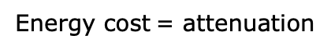
Microscopic attenuation mechanisms
Energy cost = attenuation
Incident seismic wave

Slide 19
Microscopic attenuation mechanisms
Energy cost = attenuation
Incident seismic wave
Many different dissipation mechanisms exist in the mantle (e.g. Jackson and Anderson 1970). The attenuation that a seismic wave experiences is a super-position of all these mechanisms.
Attenuation mechanisms are often thermally activated, so measuring Q can sometimes be used as a proxy for temperature

Slide 20
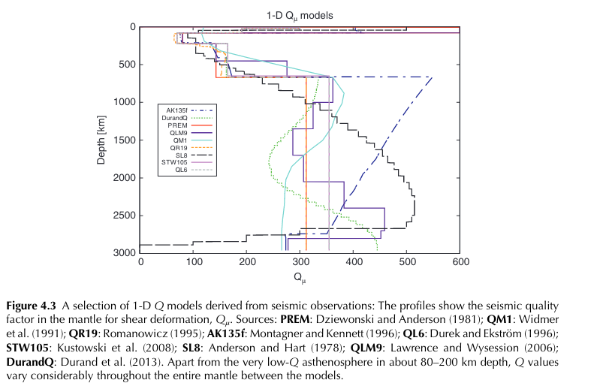
Shear attenuation profiles of Earth’s mantle
Attenuation is different for P and S waves.
We can define Q𝞵 for attenuation of waves due to shearing motion and Q𝞳 as attenuation due to volume changes
S waves are sensitive only to Q𝞵, but P waves are sensitive to both Q𝞵 and Q𝞳
Typically, Q𝞳 >> Q𝞵
Global ‘1D’ models of Q𝞵 vary considerably in the mantle, although average Q𝞵 is ~ 300
Schuberth and Bigalke, 2021

Slide 21
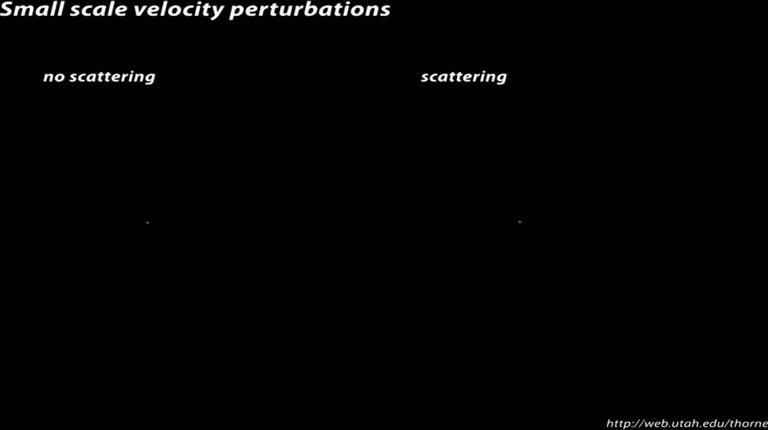
Scattering attenuation
Seismic waves can scatter from heterogeneities within the elastic medium
Scattering is efficient if the size of the scatterer is similar to the wavelength
Scattering re-distributes energy, decreasing amplitudes at the beginning of a seismogram, and increasing them in the back (the “coda”)

Slide 22
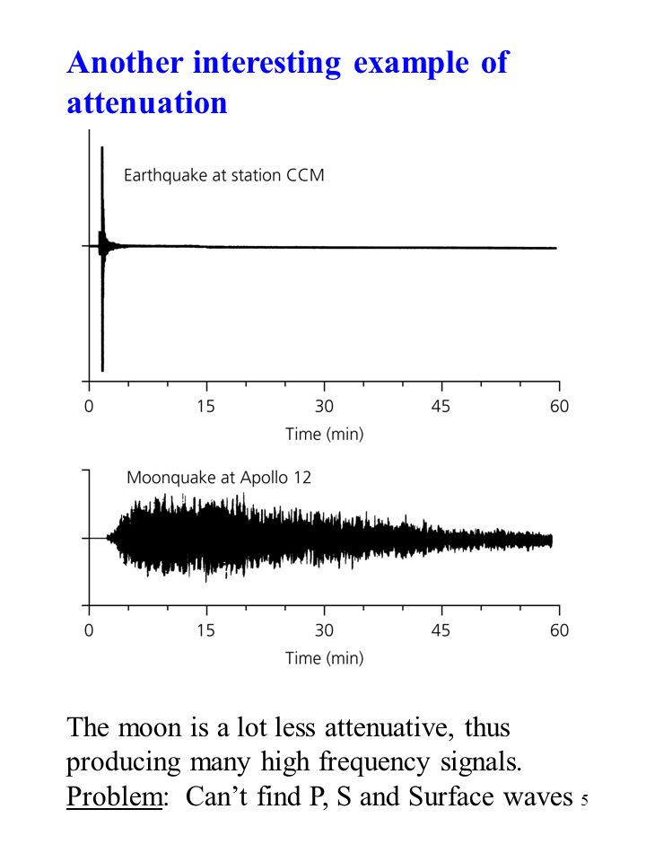
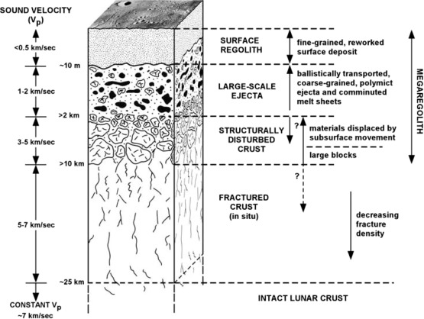
Scattering in the lunar subsurface
The lunar crust has low intrinsic attenuation, but is highly scattering, due to the dense fracture networks and the presence of a regolith layer
scattered energy arrives later

Slide 23
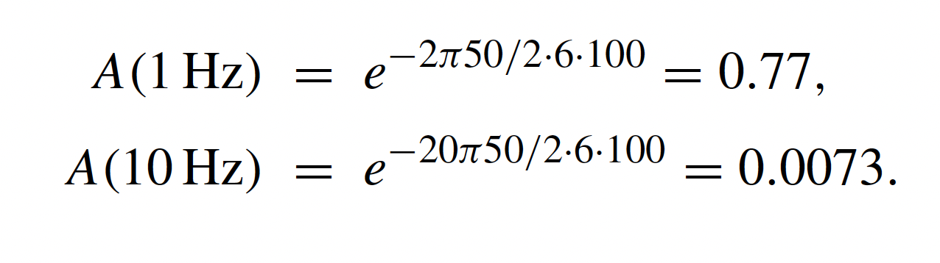
Amplitude decay due to intrinsic attenuation
The amplitude decay of a seismic wave due to attenuation can be written as
where 𝝎 is angular frequency, x is distance, c is velocity, and Q is the quality factor
An example:
Constant Q of 100, propagation distance 50 km, c = 6 km/s

Slide 24
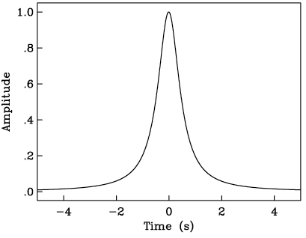
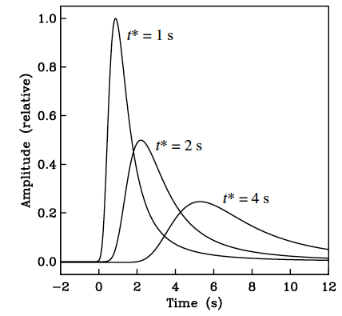
Dispersion due to attenuation
If dispersion affected amplitude only, pulses would broaden with distance, but would be symmetric.
However, this would mean that long period energy arrives before the ray theoretical travel time! (violation of causality)
In reality, attenuation effects phase also. In other words, attenuation introduces a frequency dependence on travel time (aka dispersion!)
Energy arriving earlier than it’s supposed to!

Slide 25
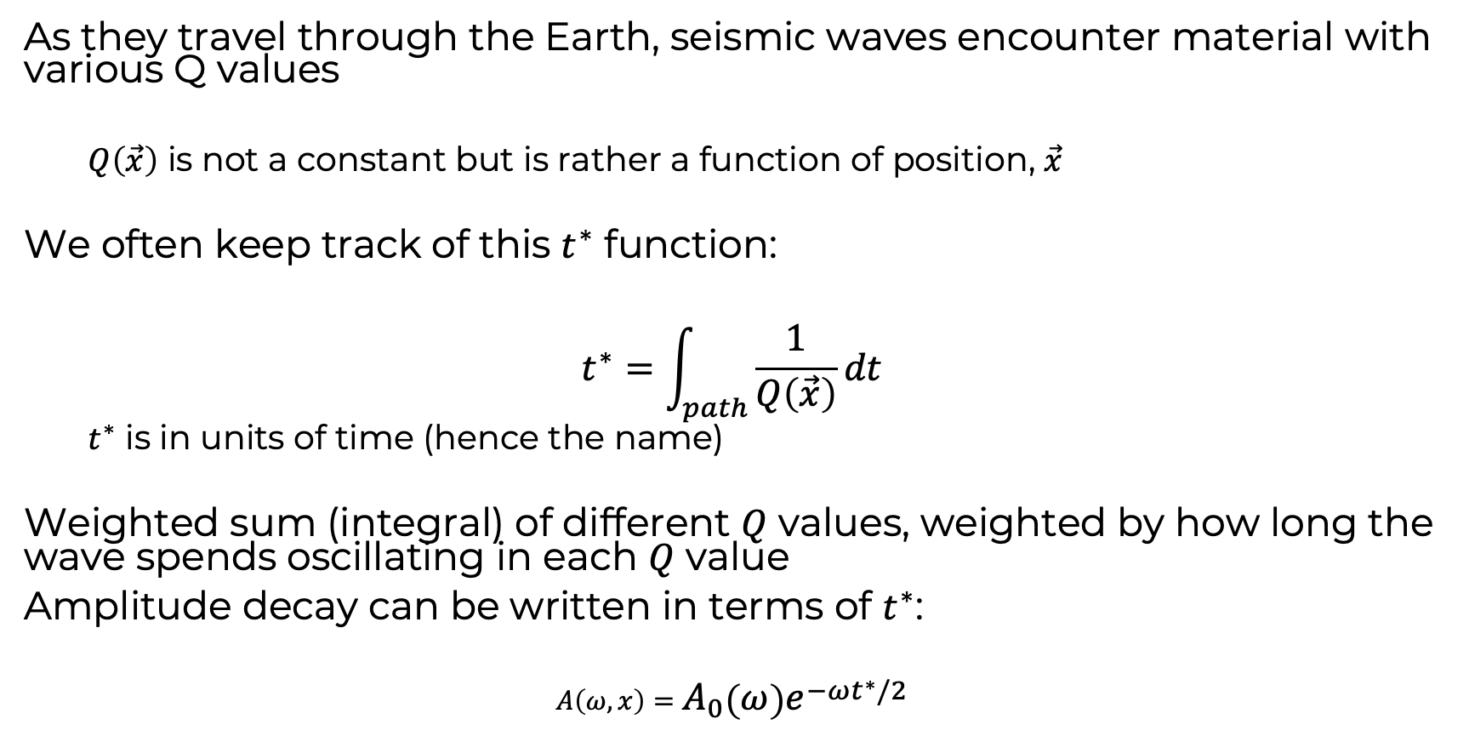
The t* (t-star) function
As they travel through the Earth, seismic waves encounter material with various Q values
$Q\left(\vec{x}\right)$ is not a constant but is rather a function of position, $\vec{x}$
We often keep track of this $t^{∗}$ function:
$$t^{∗}=\int_{path}{\frac{1}{Q\left(\vec{x}\right)}}dt$$
$t^{∗}$ is in units of time (hence the name)
Weighted sum (integral) of different $Q$ values, weighted by how long the wave spends oscillating in each $Q$ value
Amplitude decay can be written in terms of $t^{∗}$:
$$A\left(ω,x\right)=A_{0}\left(ω\right)e^{−ωt^{∗}/2}$$

Slide 26
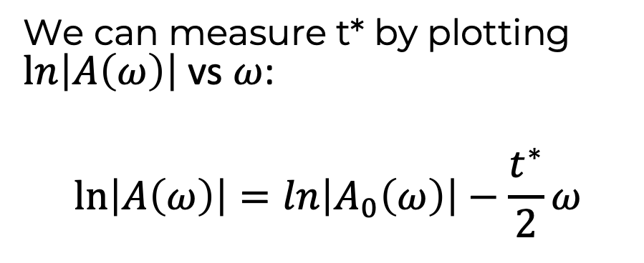
Measuring t*
We can measure t* by plotting $ln\left|A\left(ω\right)\right|$ vs $ω$:
$$ln\left|A\left(ω\right)\right|=ln\left|A_{0}\left(ω\right)\right|−\frac{t^{∗}}{2}ω$$
intercept
slope

